Slide 1
Predicting Length of Stay in a Hospital
Rosh Chan

Slide 2
Introduction
The goal of this project is to develop a predictive model that would be used to predict patients who will likely stay seven or more days in the hospital. Accurate predictive models help healthcare providers in resource allocation and patient management.

Slide 3
Data Overview
Original dataset contained 100,000 patients with 28 features
These features represented different information about the customer ranging form medical history to lab results.

Slide 4
Feature Engineering
The dataset did not contain any missing values
Created a “number_of_issues” that would represent the total number of medical conditions
Standardized our continuous lab measurements columns
Created a binary variable to represent length of stay greater than 7 as this is what we will be using our remaining features to predict.
Removed variables that were not important

Slide 5
Model Building
We created several models but narrowed it down to two:
Logistic Regression
SVM
Random Forest
Gradient Boosting Machine
Notes:
Main focus is to try and build a model with the best prediction based on this messy dataset

Slide 6
Hyperparameter Tuning
What are Hyperparameters?
Parameters of a machine learning model that are not learned from the data.
Control the learning process and model complexity.
Why is Hyperparameter Tuning Important?
Crucial for optimizing model performance.
Can significantly impact a model's accuracy and generalization.
Random Search
Randomly sample hyperparameters from predefined distributions.
Faster exploration of the search space.
Notes:
Batch hpo like random and grid search as opposed to sequential bayesian optimization

Slide 7
K-Fold Cross-Validation
Basic Concept: Split the data into 'K' equally sized folds.
Process:
Train the model on 'K-1' folds.
Validate the model on the remaining fold.
Repeat this process 'K' times, using a different fold for validation each time.
Advantages:
Reduces the risk of bias from a single train-test split.
Provides 'K' different performance estimates.

Slide 8
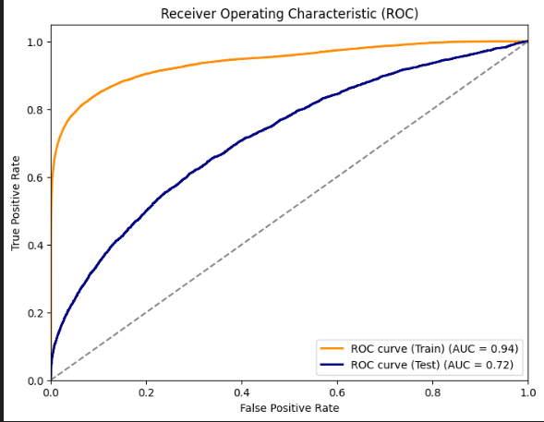
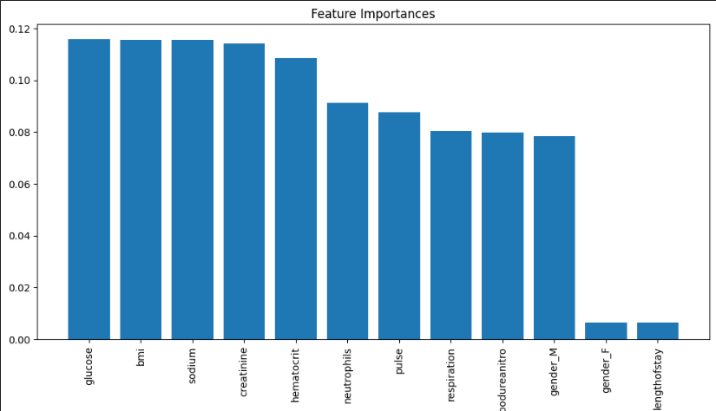
Results and Evaluation Random Forest
Notes:
ROC curves consider the entire range of possible thresholds for a binary classifier
When dealing with imbalanced datasets where one class significantly outnumbers the other, precision can be misleadingly high if the majority class is predicted correctly. ROC curves provide a more balanced view of a classifier's performance by considering true positive rate (TPR) and false positive rate (FPR) across different thresholds,

Slide 9
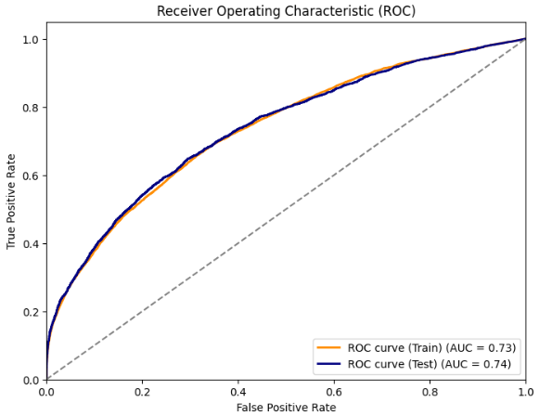
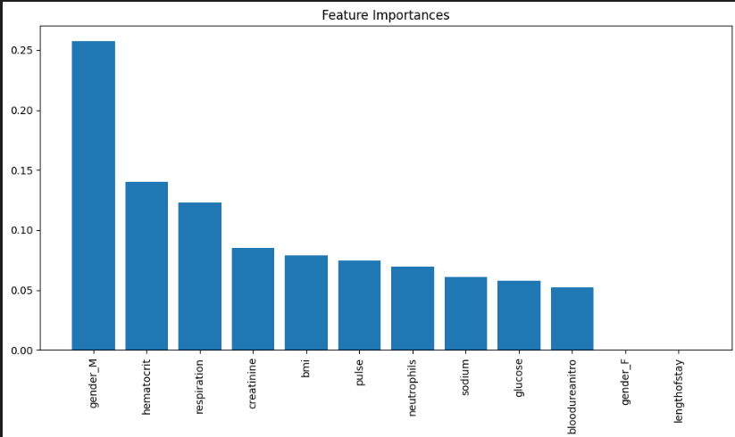
Results and Evaluation GBM

Slide 10
Conclusion
We Decided to stick with the GBM for our best model
We would like to try more methods and maybe go into deep learning
Considering key features of LOS as mentioned in the papers are not included in the dataset our model performed relatively ok.

